Slide 2




Slide 3







Slide 5
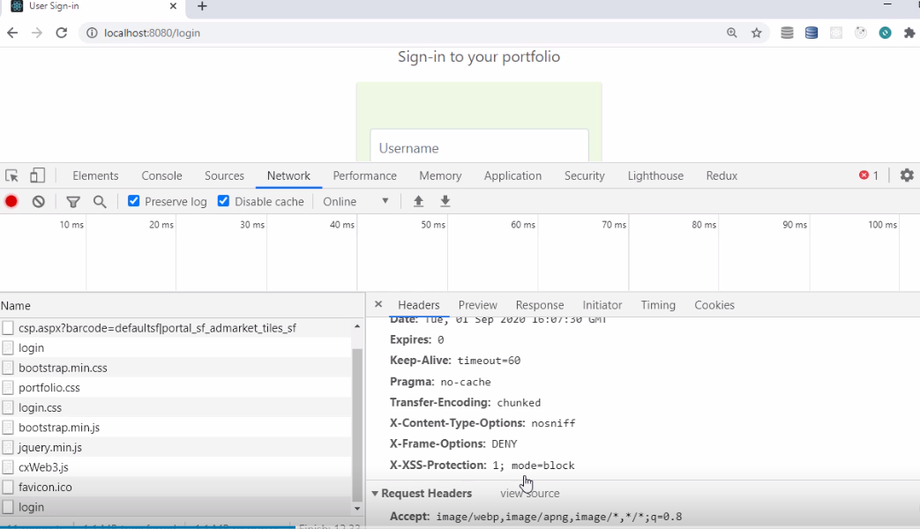

Slide 6
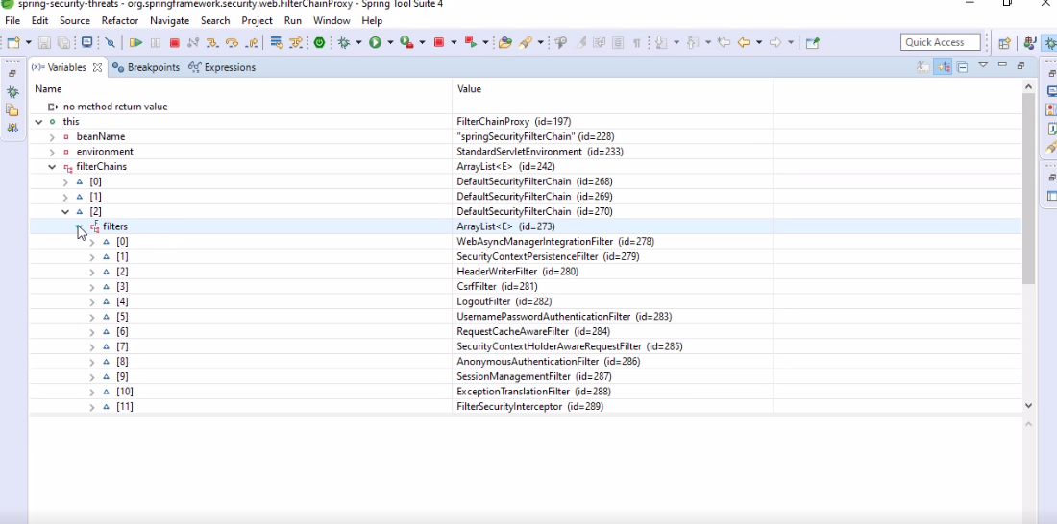

Slide 8

Cache-Control: no-cache, no-store, max-age=0, must-revalidate
Pragma: no-cache
Expires: 0

Slide 9
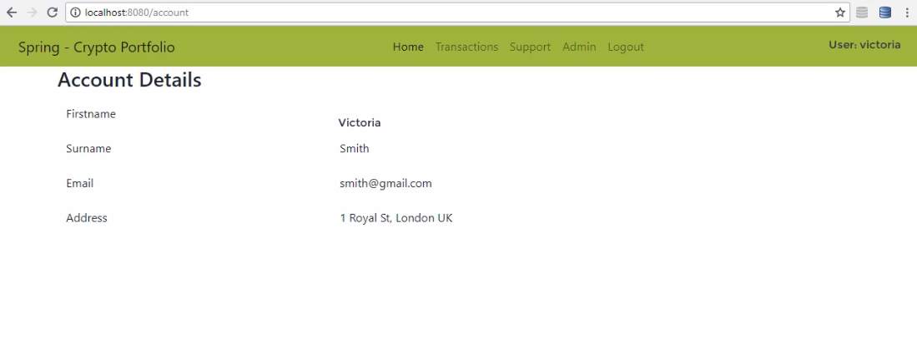

Slide 10
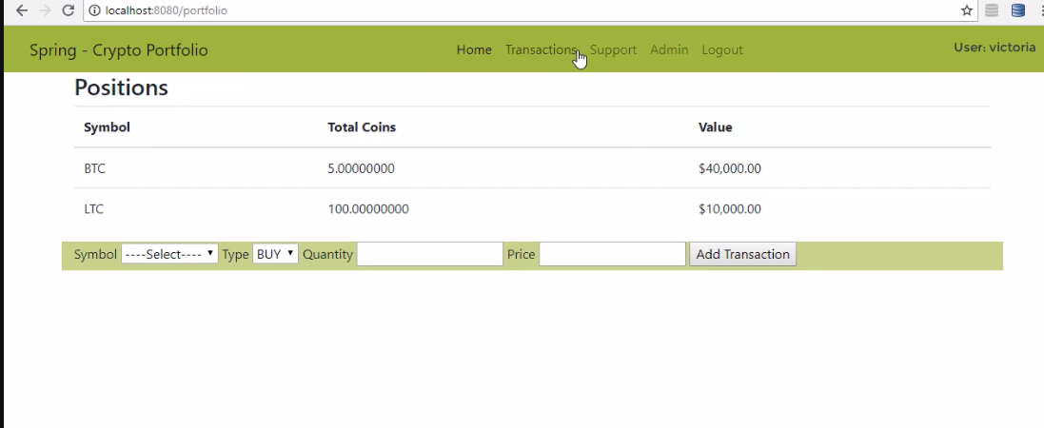

Slide 11
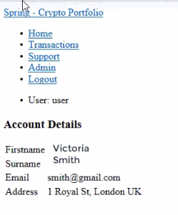
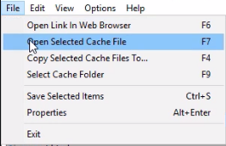

Slide 12


Slide 13






Slide 14
X-XSS-Protection: 1; mode=block

Slide 15
X-Content-Type-Options: nosniff

Slide 16


Slide 18


Slide 19
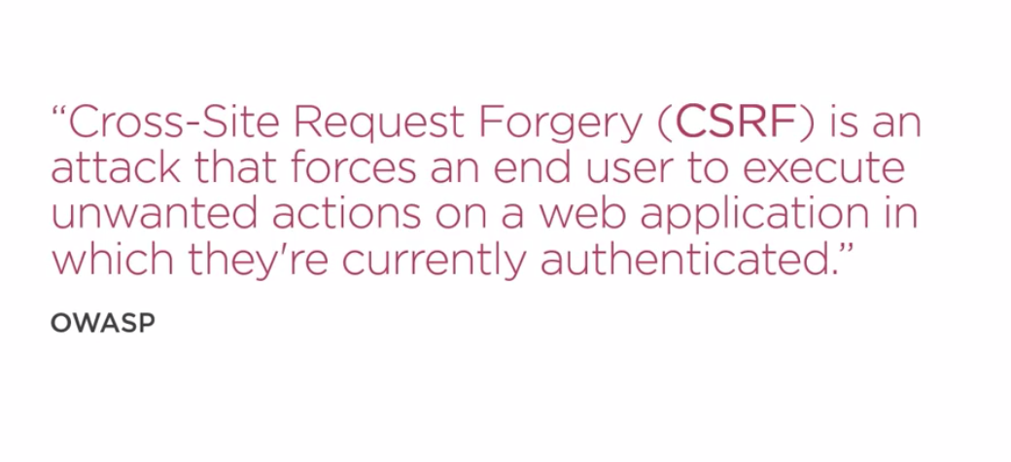

Slide 20
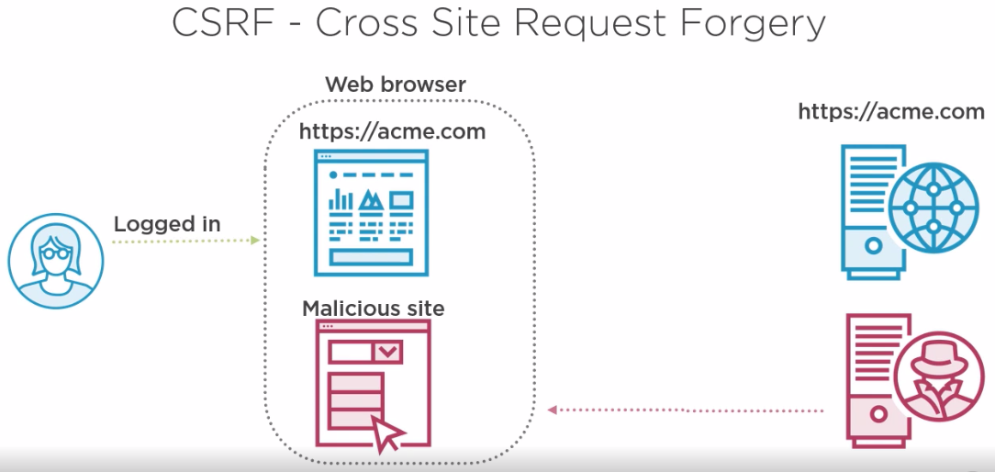

Slide 21


Slide 22
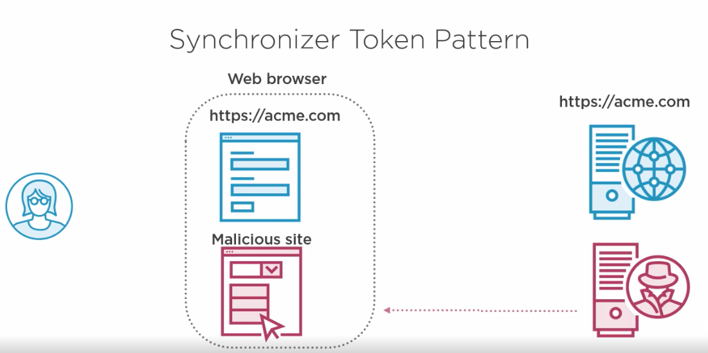

Slide 23
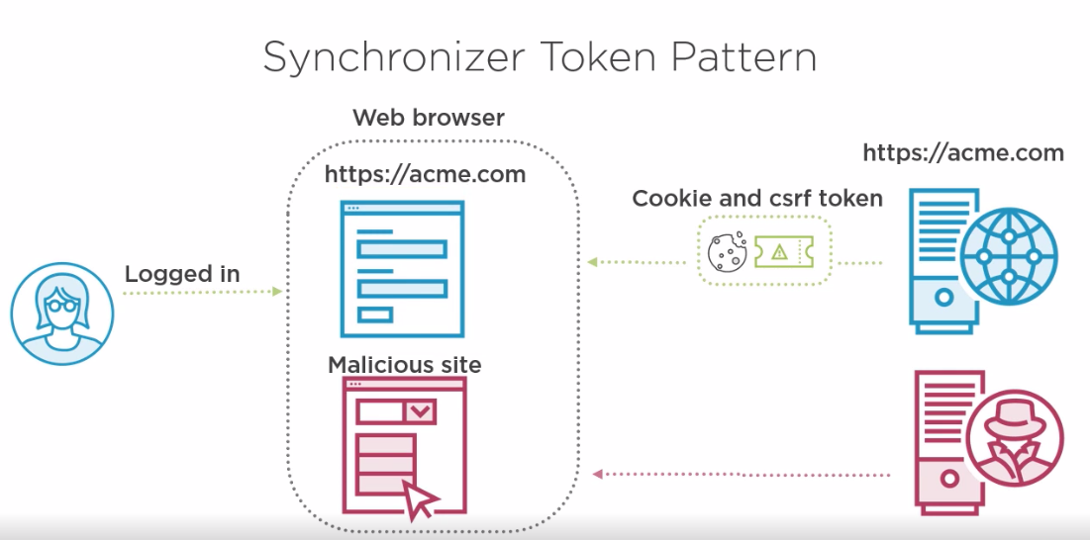

Slide 24
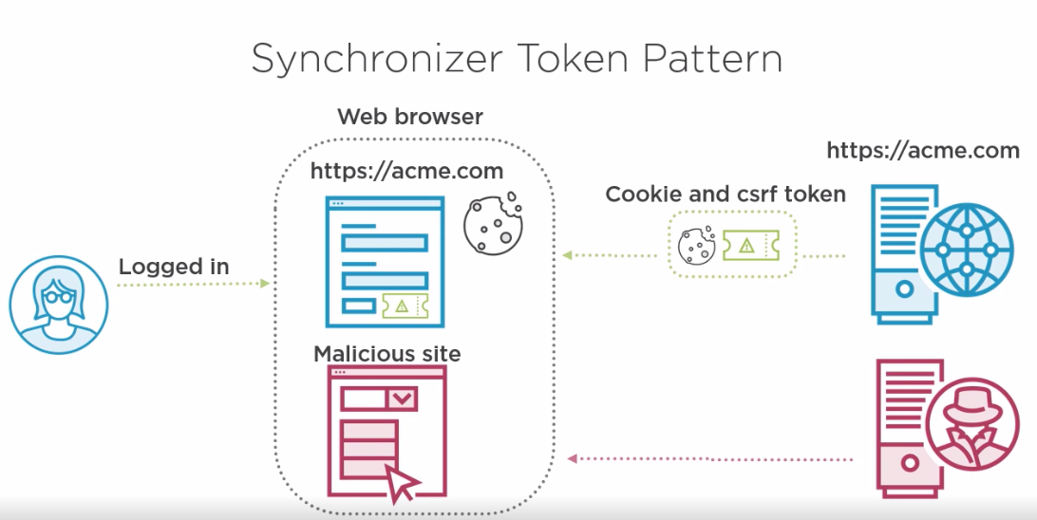

Slide 25
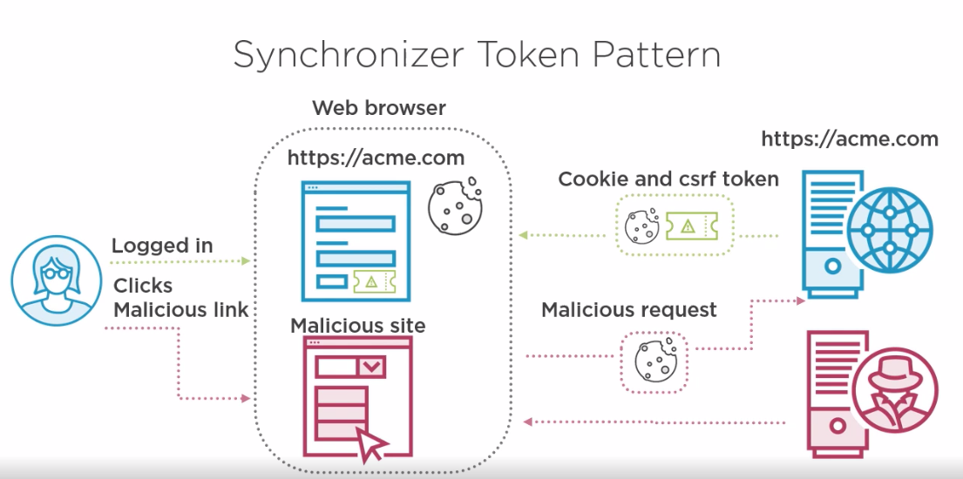

Slide 26
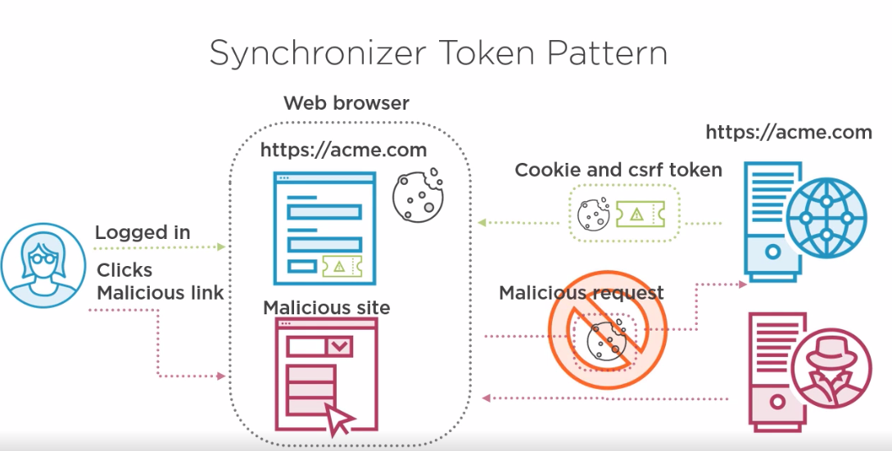

Slide 27
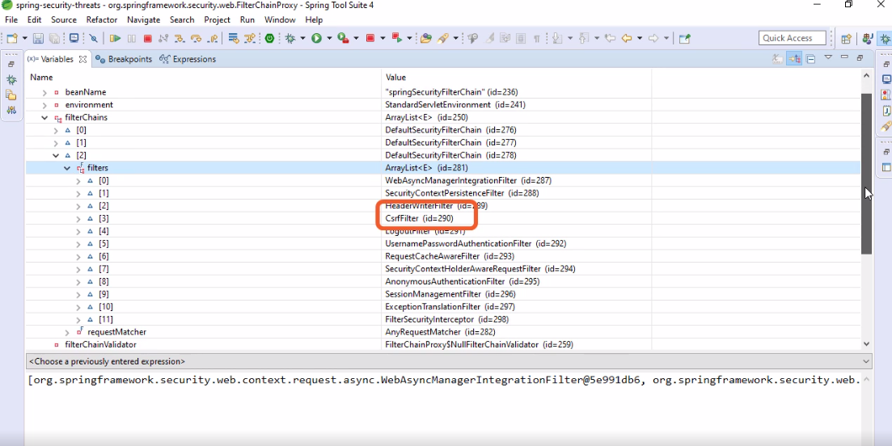

Slide 28
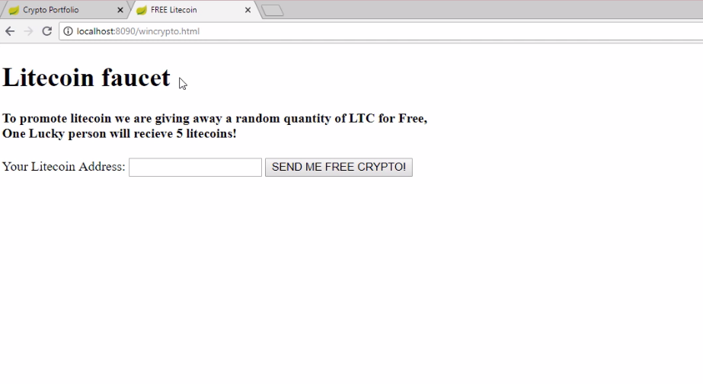

Slide 29
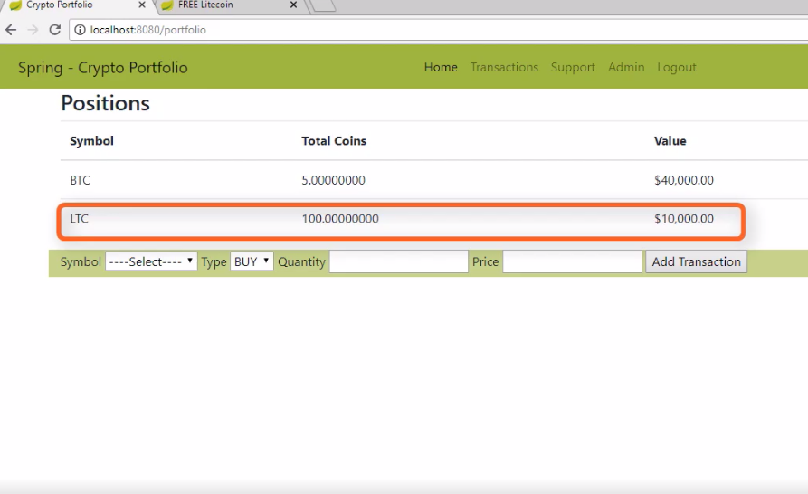

Slide 30
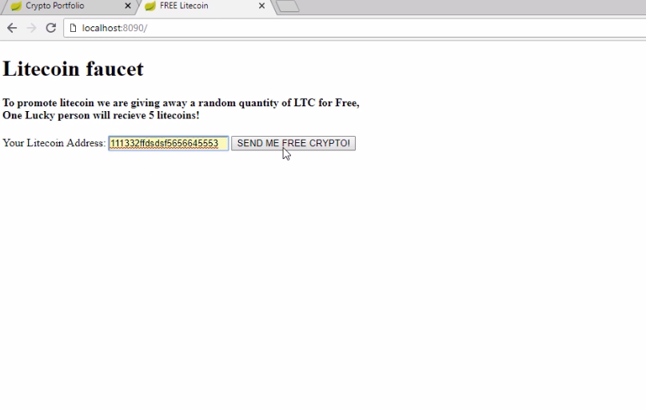

Slide 31
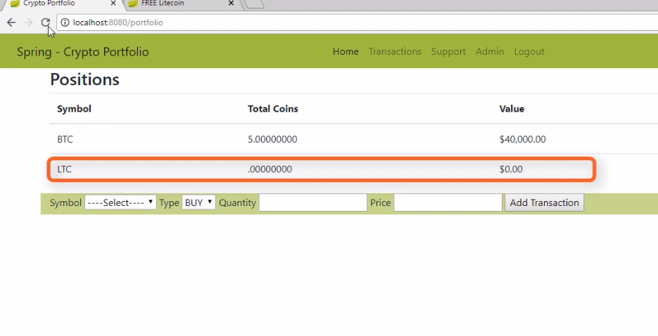

Slide 32
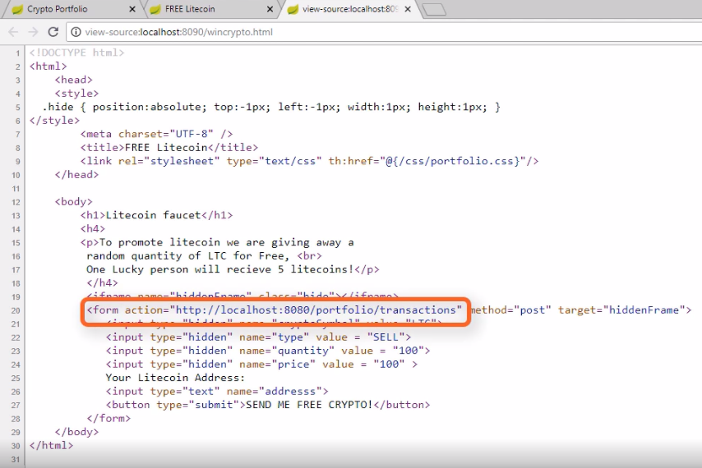

Slide 33
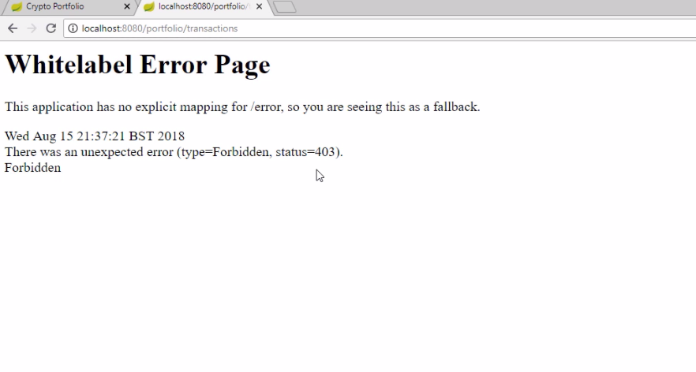

Slide 35
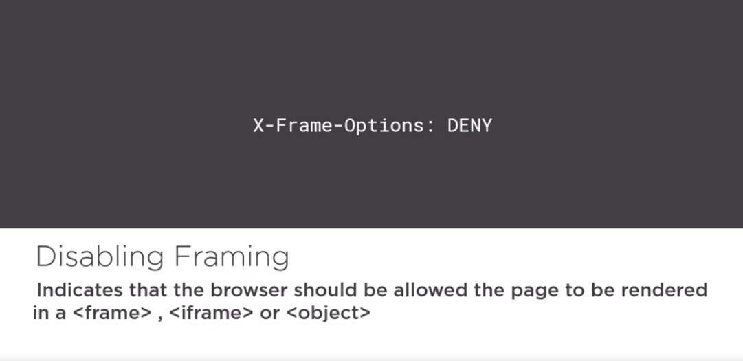

Slide 36
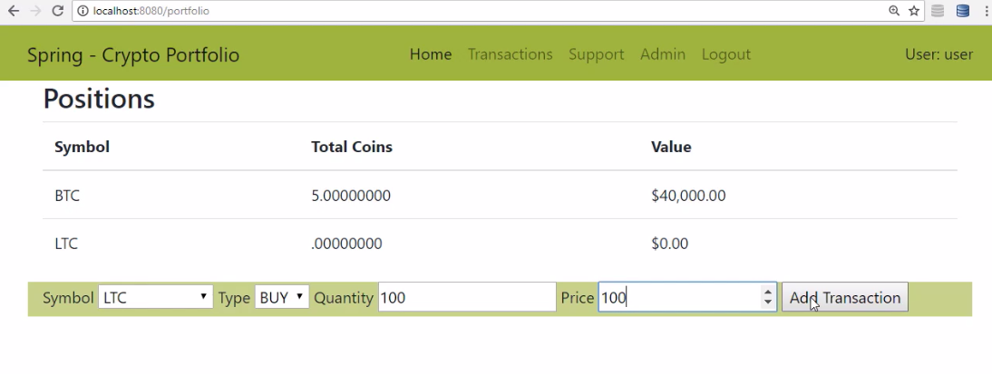

Slide 37
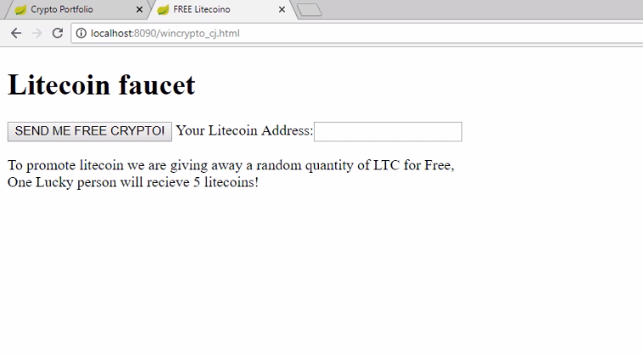

Slide 38
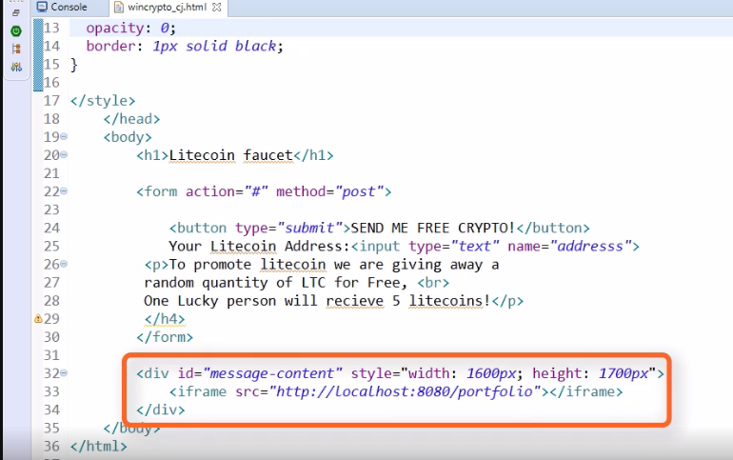
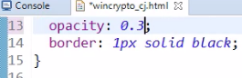

Slide 39
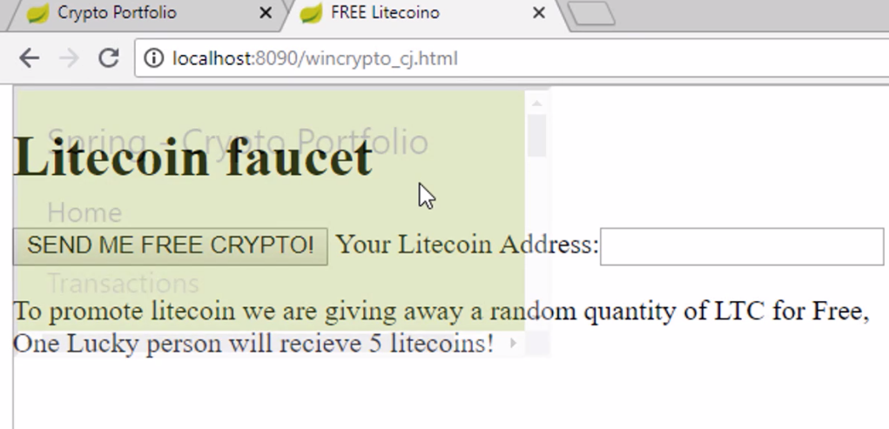

Slide 40
content-security-policy: <directive> <source list> ; <directive> <source list>
Popular directives:
default-src: Default policy for loading javascript, images, CSS, fonts,
AJAX requests.
script-src: Valid sources | for | javascript.
style-src: Valid sources | for | CSS.
img-src: Valid sources | for | images.
There are many more directives.

Slide 43








Slide 44








Slide 45







Slide 46




Slide 47








